Slide 1
The Supply Chain Planning Process
BUS-P481 “Supply Chain Planning & Analytics”
Christopher J Chen
Department of Operations and Decision Technologies

Slide 2
P481 Supply Chain Planning and Analytics
Objective: Improve your skills in quantitative, data-oriented analysis (sometimes called “analytics”) to make well-reasoned recommendations for business problems.
Context: Supply chain planning problems, in which the goal is to achieve a profitable balance between demand and supply.

Slide 3
P481 Supply Chain Planning and Analytics
Modeling
We will introduce well-known quantitative models that capture several major trade-offs inherent in supply chain planning.
We will emphasize the assumptions of the models so as to make sure we understand both their weaknesses and their strengths.
Analysis
Analysis tools help us “to ask questions to our models” and to come up with answers that help managerial decision-making.
Our analysis will rely mostly on spreadsheets. We will use Excel and several powerful add-ins.
Data
We will take it for granted that the necessary data for the analysis exists.
We will emphasize ways to use data to feed inputs to our models.

Slide 4
Example: a Supply Chain Planning Problem
Customer: the MRI unit of a health-care manufacturer.
A new MRI machine has been designed. It will be manufactured overseas and sold in the US. Should we transport the MRI machine by air freight or sea freight?
Trade-off:
Metrics:
Present a comparison of air versus sea freight in terms of metrics.
Highlight hard to quantify concerns, e.g.,

Slide 5
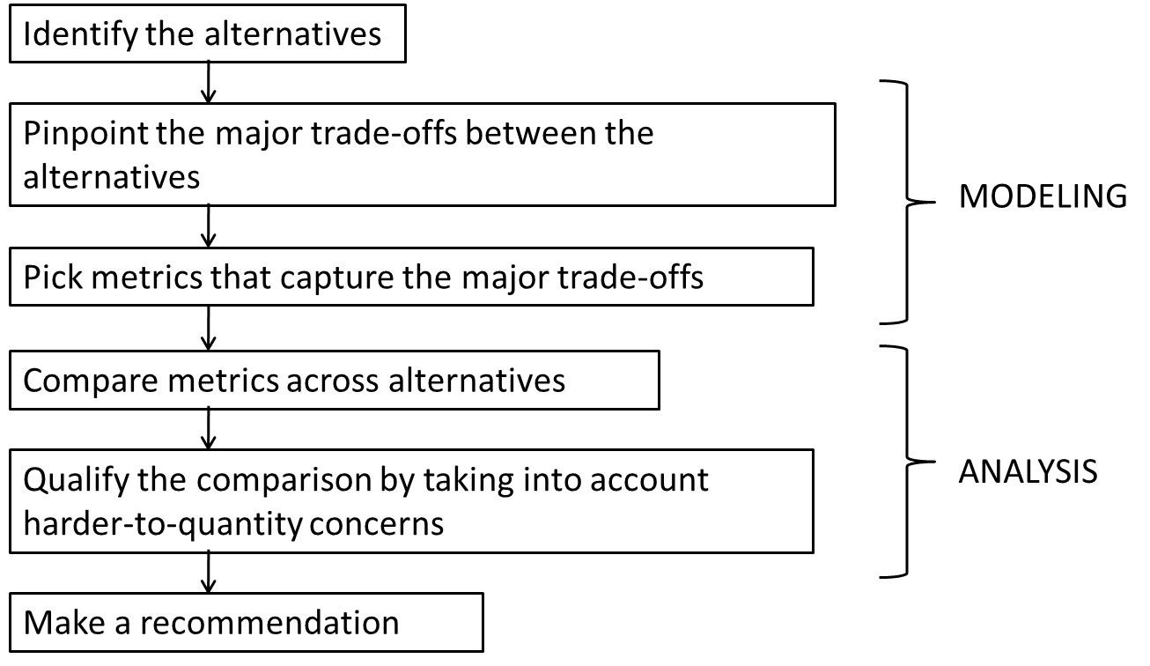
Example: a Supply Chain Planning Problem
As the MRI example suggests, making a recommendation for a business problem involves a number of steps:

Slide 6

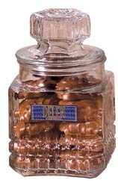

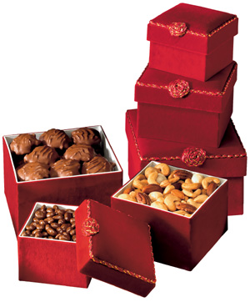
Project Examples: Catalog Retailer
Product: Gift boxes of chocolate pecans, chocolate-dipped dried fruits, etc.
Sales Channel: Mostly catalog sales through phone orders.
Selling season: Most sales occur in November and December.
Production Period: Build products to stock
in order to meet demand during the high season.
Sales Period: Limited production can be done to react
to observed demand.
January
November
December

Slide 7
Project Examples: Catalog Retailer
Supply Chain Planning Problem
Build a large quantity early on & …
Build a small quantity early on & …
Tasks:
Forecast the demand for the next holiday season.
Use this forecast in deciding how much to produce by November.
Prioritize products and schedule additional production during November and December.

Slide 8
Project Examples: Spare Part Dealers
Automotive companies like GM and Ford sell parts to thousands of dealers all over North America, who keep these parts in inventory for customers that patronize their service shops.
Central
Warehouse
Regional
Warehouse
Regional
Warehouse
Regional
Warehouse
Dealer
Dealer
Dealer
Dealer
Dealer
Dealer
Dealer
Dealer
Dealer
Dealer
Dealer
Dealer
Dealer
Dealer
Dealer

Slide 9
Project Examples: Spare Part Dealers
When a dealer runs out of a part that a customer needs, the official procedure is for the dealer to place an emergency order with the regional warehouse.
What do you think they do instead?

Slide 10
Project Examples: Spare Part Dealers
An auto manufacturer wanted to evaluate the benefits from formalizing this procedure of inventory sharing. Some of the questions were:
How to form pools of dealers that will share inventory with each other?
When a dealer receives demand for an out-of-stock part, and there are two dealers nearby that have the part, which of the two should lend the part to the out-of-stock dealer?
Does sharing help us reduce inventory in the system without worsening the customer service?

Slide 11
Applications are not all in manufacturing
Applications are not limited to traditional “supply chain” businesses:
Manufacturing
Transportation and logistics
Retail
Possible areas to use supply chain analytics:
Service operations
Healthcare
Marketing

Slide 12
The Supply Chain Planning Process
Demand Planning
Up to 2 years
Forecasting
Aggregate Supply Planning
6-18 months
“Big picture” inputs and outputs
Production Scheduling
Days to weeks
Production capacity
Workforce size
Inventory
Product-specific schedules
Available to promise
Work in process
Inventory Management & Control
Reorder point
Safety stock
Instantaneous to days/weeks
Lot or batch sizing
Product availability
Material requirements
Data gathering
Data maintenance

Slide 13
The Supply Chain Planning Process
Demand Planning
Up to 2 years
Forecasting
Aggregate Supply Planning
6-18 months
“Big picture” inputs and outputs
Production Scheduling
Days to weeks
Production capacity
Workforce size
Inventory
Product-specific schedules
Available to promise
Work in process
Inventory Management & Control
Reorder point
Safety stock
Instantaneous to days/weeks
Lot or batch sizing
Product availability
Material requirements
Data gathering
Data maintenance
Model: Time-series forecasting Tools: Excel, StatTools
Chapter 7 + Notes
Model: Linear Programming Tools: Excel, Solver
Chapters 8-9
Model: MPS, MRP Tools: Excel
Models: Classic Inventory Models Tools: Excel, Evolver, @RISK
Chapters 11-13 + Notes

Slide 14
Course Overview: OM/SCM majors
P320 Sourcing
P431 Logistics/ Distribution
P481 SC Planning/ Analytics
P429 Operations Processes
P421 Supply Chain Management
SCM major (“deep dive” into Supply Chain topics)
OM major
(“broad overview”)

Slide 15
Course Sequencing: OM/SCM majors
If you already took P421:
You do not need to do anything.
If you are currently taking P421:
We use the same textbook, but P421 is broader.
In P481 we will go deeper into the supply chain planning topics.
In P481 we will do more activities with data sets.
In P481 we will use advanced software tools not used in P421.
If you are going to take P421 in a future semester
You may find some of the topics reviewed (in less depth) when you take P421.

Slide 16
Administrative Matters: Modules & Quizzes
Prior to every class, you will work through a brief preparatory assignment, such as reading, watching a video, or a brief exercise.
All accessed through Canvas modules.
Modules help you keep up with the course material.
Module quizzes due at before each class (total 15% of final grade).
About 5 questions.
About 20 minutes time limit.
Late quizzes will be scored but earn 0 credit.
Work ahead at your own pace.
Module quizzes are due on time regardless of class attendance.

